Slide 1
Terraform Configuration for Azure Infrastructure

Slide 2
Introduction
Purpose: This presentation aims to demonstrate how Terraform can be used to automate the deployment and management of a comprehensive Azure infrastructure.
Scope: We will cover the key components involved, including resource groups, virtual networks, subnets, network security groups, public IPs, network interfaces, route tables, and virtual machines.

Slide 3
Overview
Infrastructure Components:
Resource Group
Virtual Network (VNet)
Subnets (Public and Private)
Network Security Group (NSG)
Public IP
Network Interface
Route Tables
Virtual Machine (VM)
Tools Used: Terraform, AzureRM Provider

Slide 4
Azure Infrastructure Overview
Resource Group
Purpose: Central container for managing Azure resources.
Detail: Named "main-resource-group" in the "West US" region.
Virtual Network (VNet)
Purpose: Establishes a virtual network for resource communication.
Detail:
Name: "main-vnet"
Address Space: 10.0.0.0/16
Subnets
Public Subnet:
Purpose: Allows external access.
Detail: Address Prefix: 10.0.1.0/24
Private Subnet:
Purpose: Isolated environment for internal resources.
Detail: Address Prefix: 10.0.2.0/24

Slide 5
Azure Infrastructure Overview
Network Security Group (NSG)
Purpose: Controls inbound and outbound traffic.
Detail:
Name: "main-nsg"
Rules: Allow SSH (Port 22), HTTP (Port 80), HTTPS (Port 443)
Public IP
Purpose: Provides external access to the VM.
Detail: Dynamic allocation for "main-public-ip"
Network Interface
Purpose: Connects VM to the network.
Detail:
Name: "main-nic"
Associated with Public Subnet and Public IP

Slide 6
Azure Infrastructure Overview
Route Tables
Public Subnet Route Table:
Purpose: Directs traffic to the internet.
Detail: Routes 0.0.0.0/0 to Internet
Private Subnet Route Table:
Purpose: Manages internal VNet traffic.
Detail: Routes 10.0.0.0/16 within the VNet
Virtual Machine (VM)
Purpose: Deploys a Linux VM for various workloads.
Detail:
Size: Standard_B1ls
OS: Ubuntu 18.04 LTS
Located in Public Subnet with NSG and Public IP

Slide 7
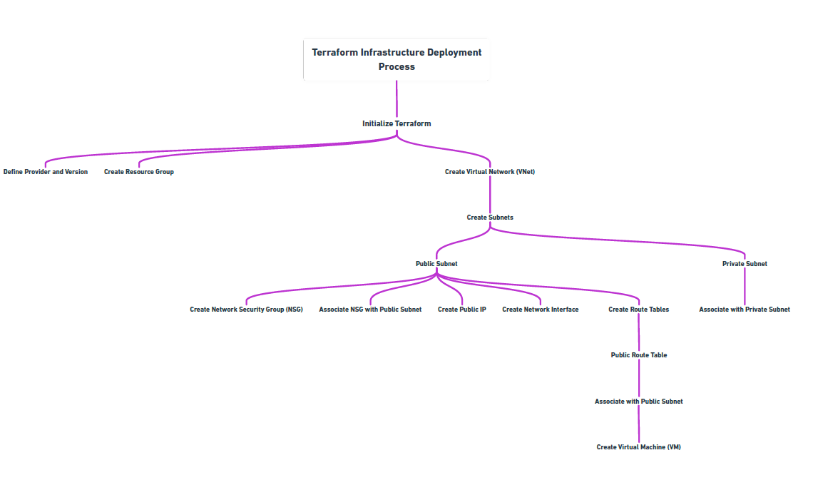
Flowchart

Slide 8
Conclusion
Summary:
Automated deployment of Azure resources using Terraform.
Benefits:
Consistency, repeatability, and scalability.

